Slide 1
PYTHON TUTORIALS
OOPS
SHALINI SHEETAL
CSE, THIRD YR

Slide 2
What is OOPS ?
Object-Oriented Programming
In Python, object-oriented Programming (OOPs) is a programming paradigm that uses objects and classes in programming.
It aims to implement real-world entities like inheritance, polymorphisms, encapsulation, etc. in the programming.
The main concept of OOPs is to bind the data and the functions that work on that together as a single unit so that no other part of the code can access this data.

Slide 3
Concepts of OOPS
CLASS
A class is a collection of objects.
A class contains the blueprints or the prototype from which the objects are being created.
It is a logical entity that contains some attributes and methods.
Classes are created by keyword class.
Attributes are the variables that belong to a class.
Attributes are always public and can be accessed using the dot (.) operator. Eg.: Myclass.Myattribute

Slide 4
Concepts of OOPS
OBJECTS
The object is an entity that has a state and behavior associated with it.
It may be any real-world object like a mouse, keyboard, chair, table, pen, etc.
Integers, strings, floating-point numbers, even arrays, and dictionaries, are all objects. More specifically, any single integer or any single string is an object.
An object consists of :
State: It is represented by the attributes of an object. It also reflects the properties of an object.
Behavior: It is represented by the methods of an object. It also reflects the response of an object to other objects.
Identity: It gives a unique name to an object and enables one object to interact with other objects.

Slide 5
Concepts of OOPS
INHERITANCE
Inheritance is the capability of one class to derive or inherit the properties from another class.
The class that derives properties is called the derived class or base class and the class from which the properties are being derived is called the base class or parent class.
The benefits of inheritance are:
It represents real-world relationships well.
It provides the reusability of a code. We don’t have to write the same code again and again. Also, it allows us to add more features to a class without modifying it.
It is transitive in nature, which means that if class B inherits from another class A, then all the subclasses of B would automatically inherit from class A.

Slide 6
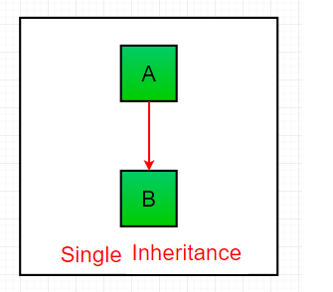
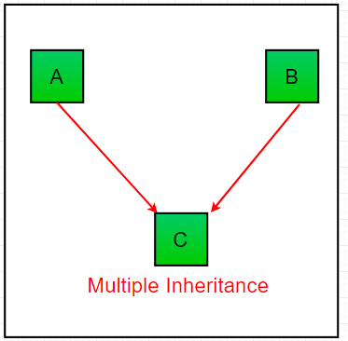
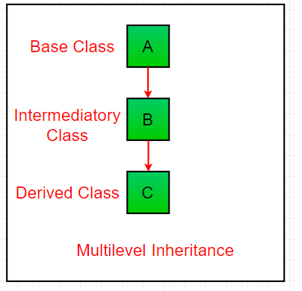
Types of inheritance
Single inheritance
Multiple inheritance
Multilevel inheritance
Enables a derived class to inherit properties from a single parent class, thus enabling code reusability and the addition of new features to existing code.
When a class can be derived from more than one base class. All the features of the base classes are inherited into the derived class.
Features of the base class and the derived class are further inherited into the new derived class. This is similar to a relationship representing a child and grandfather.

Slide 7
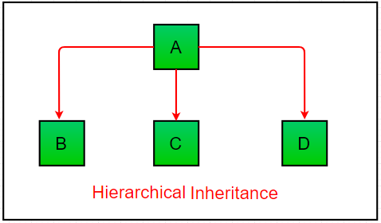
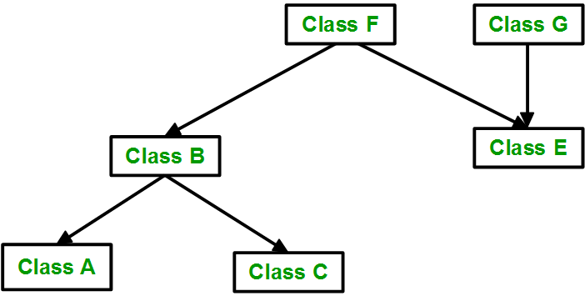
Types of inheritance
Hierarchical inheritance
Hybrid inheritance
When more than one derived classes are created from a single base. In this program, we have a parent (base) class and two child (derived) classes.
Hybrid inheritance involves multiple inheritance taking place in a single program.

Slide 8
Concepts of OOPS
POLYMORPHISM
The word polymorphism means having many forms.
In programming, polymorphism means the same function name (but different signatures) being used for different types.
# Python program to demonstrate in-built poly-
# morphic functions
# len() being used for a string
print(len(“shecoders"))
# len() being used for a list
print(len([10, 20, 30]))

Slide 9
Concepts of OOPS
ENCAPSULATION
Encapsulation is one of the fundamental concepts in object-oriented programming (OOP).
It describes the idea of wrapping data and the methods that work on data within one unit.
This puts restrictions on accessing variables and methods directly and can prevent the accidental modification of data.
To prevent accidental change, an object’s variable can only be changed by an object’s method. Those types of variables are known as private variables.
A class is an example of encapsulation as it encapsulates all the data that is member functions, variables, etc.

